Slide 1

Unit 1
How can we become good
learners?
Section A Grammar Focus

Slide 2

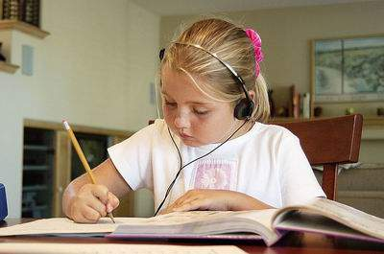
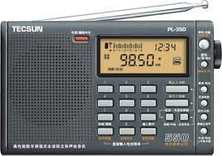
A. Listening
listening to
English songs
listening to
English tapes
listening to
English radios

Slide 3
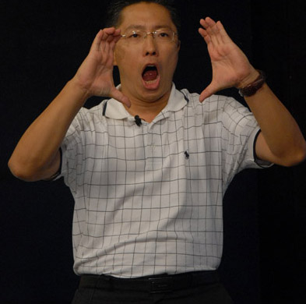

B. Speaking
speaking English
aloud
speaking English
crazily

Slide 4


C. Reading
PPT模板：www.1ppt.com/moban/ PPT素材：www.1ppt.com/sucai/
PPT背景：www.1ppt.com/beijing/ PPT图表：www.1ppt.com/tubiao/
PPT下载：www.1ppt.com/xiazai/ PPT教程： www.1ppt.com/powerpoint/
资料下载：www.1ppt.com/ziliao/ 范文下载：www.1ppt.com/fanwen/
试卷下载：www.1ppt.com/shiti/ 教案下载：www.1ppt.com/jiaoan/
PPT论坛：www.1ppt.cn PPT课件：www.1ppt.com/kejian/
语文课件：www.1ppt.com/kejian/yuwen/ 数学课件：www.1ppt.com/kejian/shuxue/
英语课件：www.1ppt.com/kejian/yingyu/ 美术课件：www.1ppt.com/kejian/meishu/
科学课件：www.1ppt.com/kejian/kexue/ 物理课件：www.1ppt.com/kejian/wuli/
化学课件：www.1ppt.com/kejian/huaxue/ 生物课件：www.1ppt.com/kejian/shengwu/
地理课件：www.1ppt.com/kejian/dili/ 历史课件：www.1ppt.com/kejian/lishi/
reading English
aloud
reading English
crazily
Notes:
PPT模板：www.1ppt.com/moban/ PPT素材：www.1ppt.com/sucai/
PPT背景：www.1ppt.com/beijing/ PPT图表：www.1ppt.com/tubiao/
PPT下载：www.1ppt.com/xiazai/ PPT教程： www.1ppt.com/powerpoint/
资料下载：www.1ppt.com/ziliao/ 范文下载：www.1ppt.com/fanwen/
试卷下载：www.1ppt.com/shiti/ 教案下载：www.1ppt.com/jiaoan/
PPT论坛：www.1ppt.cn PPT课件：www.1ppt.com/kejian/
语文课件：www.1ppt.com/kejian/yuwen/ 数学课件：www.1ppt.com/kejian/shuxue/
英语课件：www.1ppt.com/kejian/yingyu/ 美术课件：www.1ppt.com/kejian/meishu/
科学课件：www.1ppt.com/kejian/kexue/ 物理课件：www.1ppt.com/kejian/wuli/
化学课件：www.1ppt.com/kejian/huaxue/ 生物课件：www.1ppt.com/kejian/shengwu/
地理课件：www.1ppt.com/kejian/dili/ 历史课件：www.1ppt.com/kejian/lishi/

Slide 5
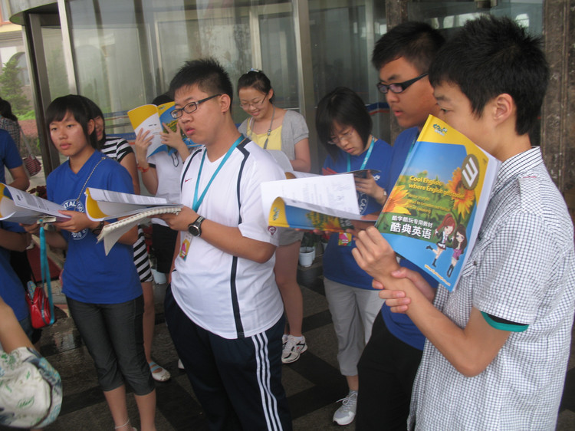
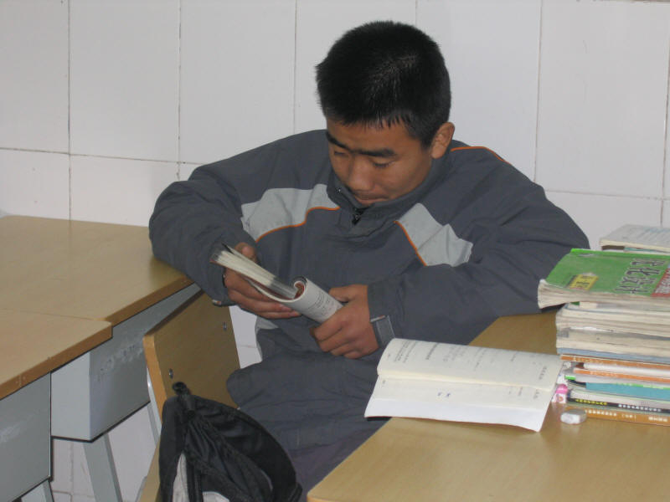
reading English
textbooks
reading English
notes

Slide 6


reading English
newspapers
reading English
magazines

Slide 7


D. Writing
writing emails
to your friends
writing/keeping
diaries in English

Slide 8




E. Watching
watching
English DVDs
watching
English TV
watching
English films

Slide 9

Review - look and say
She learns English
by working with friends.
She learns English
by making word cards.

Slide 10
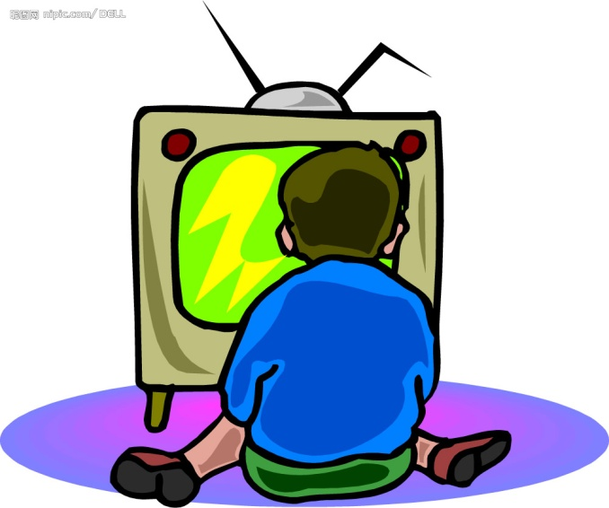
He learns English
by reading the textbook.
He learns English
by watching TV.

Slide 11
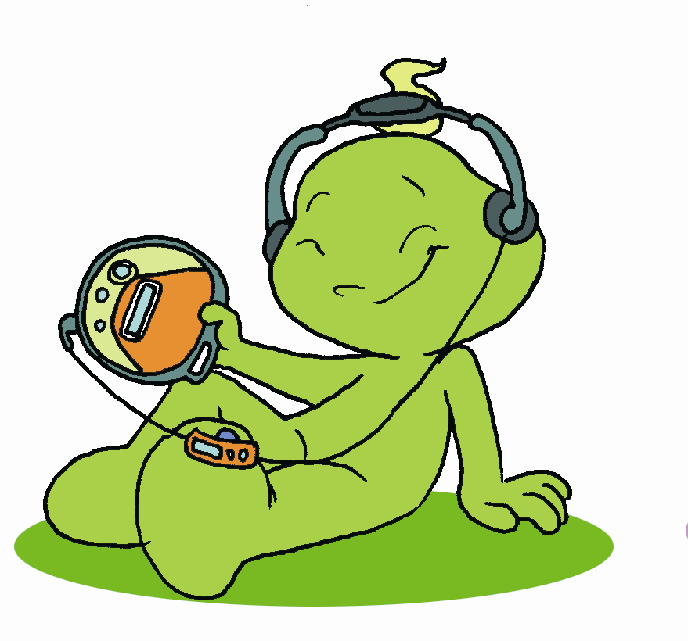
He learns English
by listening to tapes.
He learns English
by asking the teacher for help.

Slide 12
Grammar Focus
How do you learn English? | I learn by studying with a group.
Do you learn English by reading aloud? | Yes, I do. It helps my pronunciation.
How can I read faster? | You can read faster by reading word groups.
How can I improve my pronunciation? | One way is by listening to tapes.

Slide 13
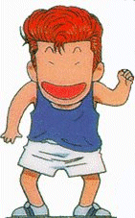
Can you help me?
I have difficulties in
learning English.

Slide 14
1a Learning English can be difficult. What things are difficult for you? Read the list. Check (✔) the statements that are true for you.
I can’t pronounce some of the words.
I can’t understand spoken English.
I don’t know how to increase my reading speed.
I can’t spell some English words.
I often make mistakes in grammar.

Slide 15
What other things are difficult for you?
Make a list. (1b)
don’t know enough words to write well.
can’t get the pronunciation right
can’t always make complete sentences
forget a lot of new words
can’t understand when people speak too
quickly
don’t get much writing practice

Slide 16
1c Paul finds it difficult to learn English.
Listen and complete the learning challenges
he talks about.
Chanllenges
1. He can’t get the______________ right.
2. He___________ a lot of new words.
3. He can’t always__________ when people
talk to him.
4. He doesn’t get much___________ practice.
pronunciation
forgets
understand
writing

Slide 17
1d Listen again. Complete the solutions.
Solutions
1. ________________ can help.
He can always_____________________ in
his notebook and study them at home.
He can________________________
to practice speaking.
He should find a_______ to practice writing.
Listening
write the new words
join an English language club
pen pal

Slide 18
1e Role-play conversations using the
information in 1c and 1d.
A: I don’t have a partner to practice
English with.
B: Maybe you should join an English club.
A: I can’t get the pronunciation right.
B: Maybe you should listen tapes.

Slide 19

Pair work
A: I forget a lot of new words.
B: Maybe you should write the new words
in your notebook and study them at
home.
A: I can’t always understand when people
talk to me.
B: Maybe you should join an English
language club to practice speaking.

